Slide 1


Session 6:Libraries and capstone project
Middlesex Computing Society: Python Programming
Arfa Kazi, Head of Python Programming

Slide 2

Last week’s recap
Understand the principles of Object-Oriented Programming (OOP).
Learn how to define and create classes and objects.
Understand and implement class attributes and methods.
Explore the concepts of inheritance, polymorphism, encapsulation, and abstraction.

Slide 3

This Week’s objectives:
Understand the role and importance of libraries.
Learn how to install and import popular libraries.
Discuss the capstone project requirements and objectives.
Brainstorm and select a project idea based on learned concepts.

Slide 4


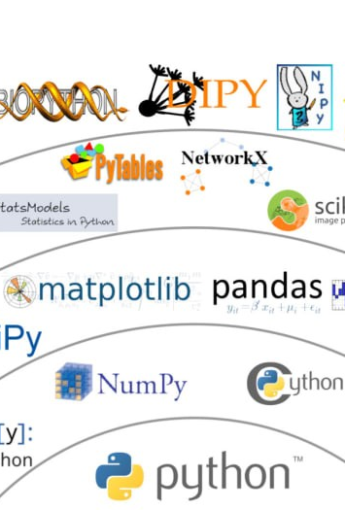
What is a library?
Python libraries are collections of pre-written code that you can use in your programs.
They help to simplify complex tasks and add functionality without writing code from scratch. Libraries can include modules, functions, and classes.
Benefits of Libraries:
Code Reusability: Avoid reinventing the wheel.
Efficiency: Save time and effort.
Community Support: Access to a wealth of resources and documentation.
Consistency: Standardized solutions and best practices

Slide 5
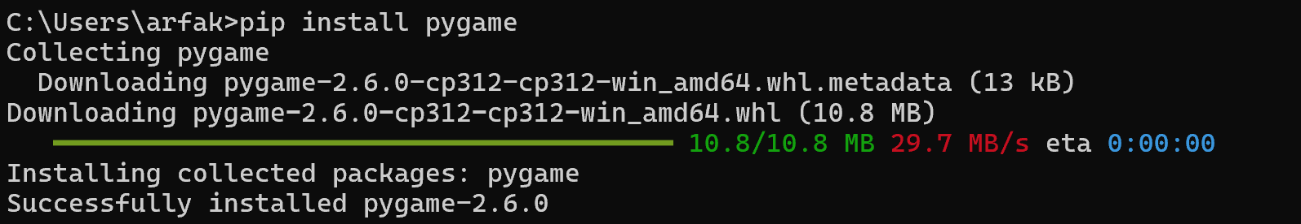

Slide 6


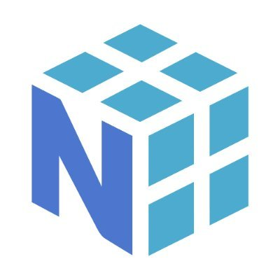
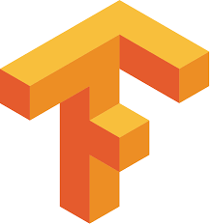

Libraries covered today:
Numpy
Matplotlib
Pandas
TensorFlow
Django

Slide 7
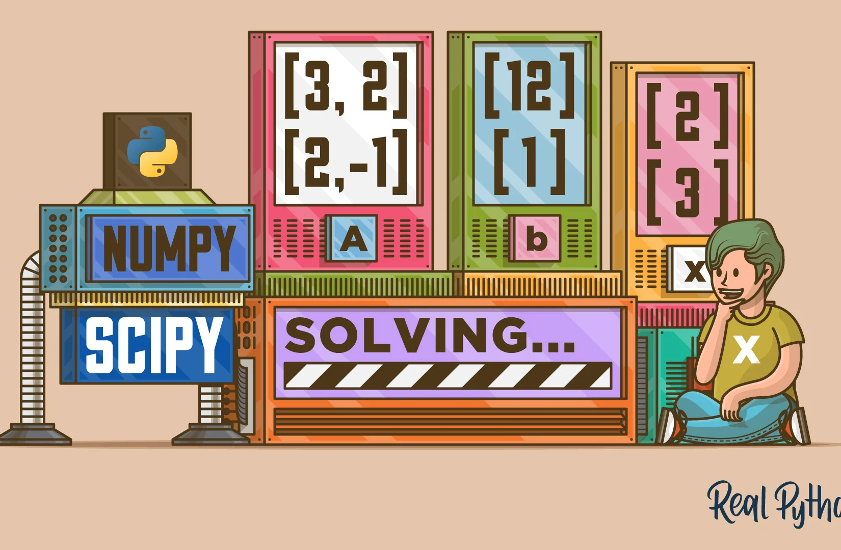
Numpy (Numeric Python)
Provides support for large, multi-dimensional arrays and matrices, along with a collection of mathematical functions to operate on them.
Key Features:
Efficient array computations
Mathematical functions (e.g., linear algebra, random number generation).
Used in data analysis and scientific computing.
pip install numpy
https://numpy.org/

Slide 8
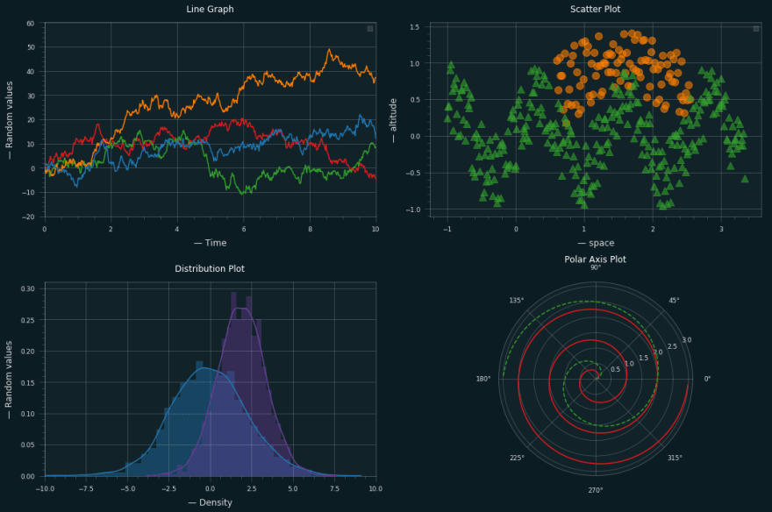
Matplotlib: Plotting Library
A library for creating static, animated, and interactive visualizations in Python.
Key Features:
Line plots, bar charts, histograms, and more.
Customizable plots with labels, titles, and legends.
Used in Data visualization in reports and presentations.
pip install matplotlib
https://matplotlib.org/

Slide 9
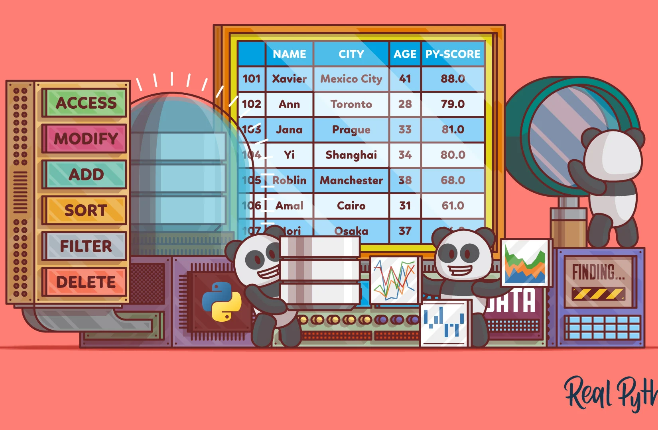
Pandas: Data Manipulation and Analysis
Provides data structures and data analysis tools.
Key Features:
DataFrames: Two-dimensional, size-mutable, and tabular data.
Series: One-dimensional labeled arrays capable of holding any data type.
Data cleaning and transformation.
pip install pandas
https://pandas.pydata.org/

Slide 10
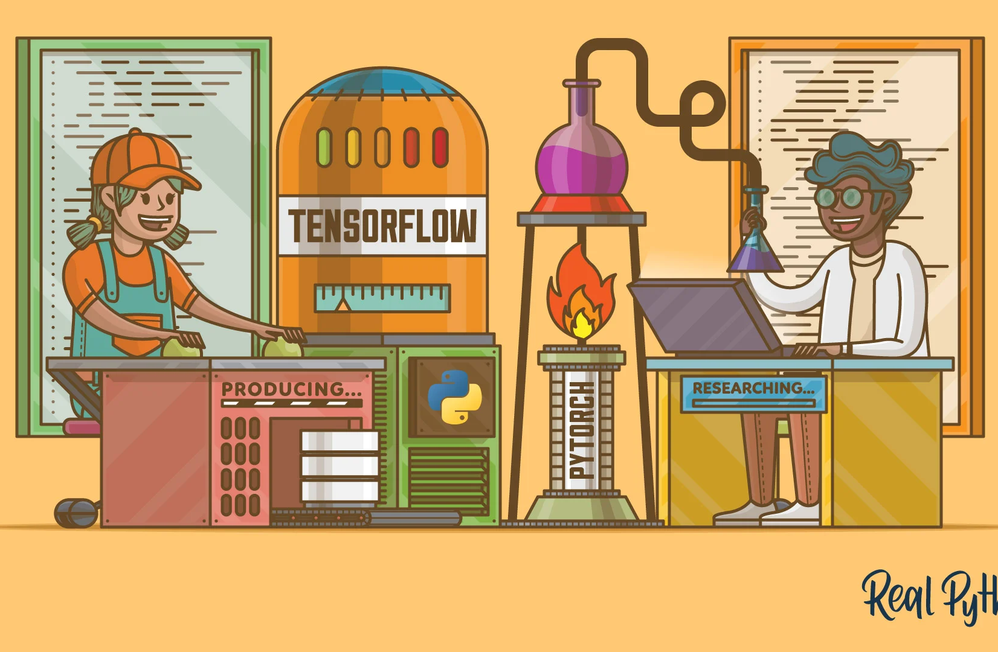
TensorFlow
TensorFlow is an open-source machine learning framework developed by Google. It is used for building and deploying machine learning models, especially deep learning neural networks.
Key Features:
Versatility: Supports a wide range of tasks, from image and speech recognition to natural language processing.
Scalability: Can be deployed on various platforms, including desktops, servers, and mobile devices.
Extensive Community: A large ecosystem of tools, libraries, and community support.
Example Uses: Image Classification, Natural Language Processing (NLP)
https://www.tensorflow.org/learn

Slide 11
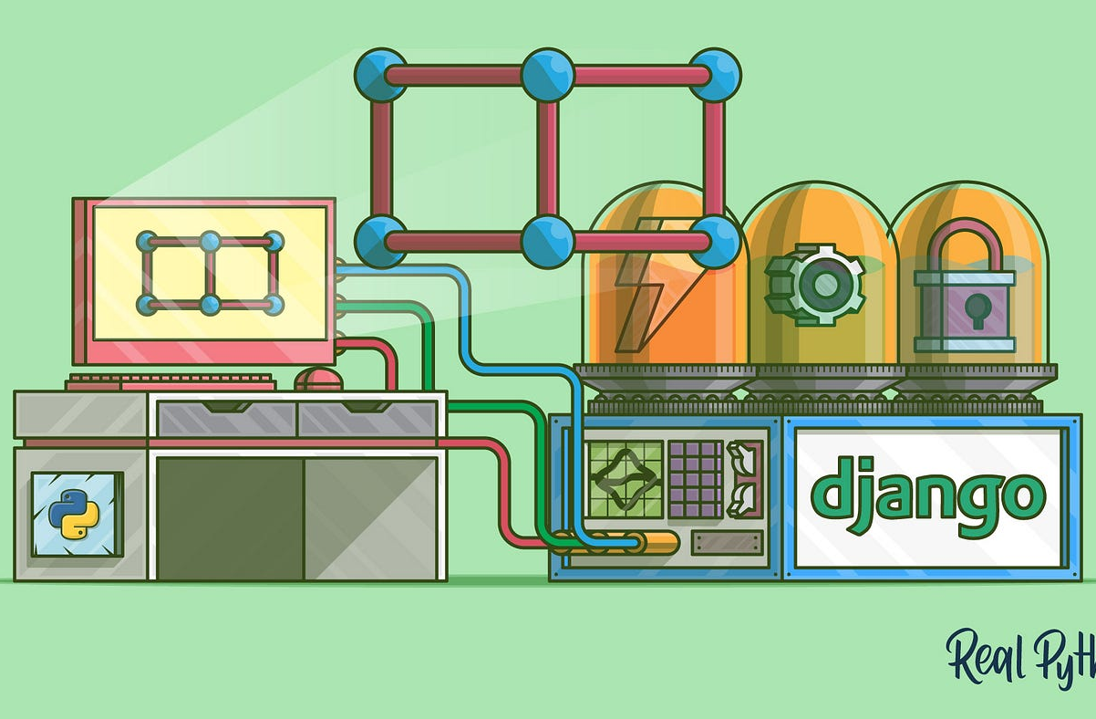
Django
Django is a high-level, open-source web framework written in Python. It follows the "batteries-included" philosophy, providing many features out-of-the-box to facilitate rapid development of secure and maintainable websites.
Key Features:
Rapid Development: Built-in features like authentication, URL routing, and a templating engine.
Security: Includes protections against common web vulnerabilities, such as SQL injection and cross-site scripting (XSS).
Scalability: Suitable for small projects and large, complex web applications.
Example Uses: Web Applications, APIs
https://www.djangoproject.com/

Slide 12
Other Useful Libraries
SciPy: Used for scientific and technical computing.
Scikit-learn: Machine learning library for Python.
OpenCV: Library for computer vision.
Requests: HTTP library for sending HTTP requests.
Beautiful Soup: library allowing you to extract data from HTML and XML files.
Bokeh: A library for creating interactive visualizations for modern web browsers.

Slide 13

Capstone Project!
Your final step in this Study Group!!

Slide 14
Details about capstone project
Objective: Apply the skills and knowledge gained over the course.
Project Scope: Create a comprehensive project using at least one Python library or module and the various concepts learned throughout this 6 weeks.
Project Guidelines:
Must include user input, data processing, and output.
Use at least one external Library/Module.
Incorporate visualizations if applicable.
Needs to be well commented

Slide 15
Capstone Project Ideas
Data Analysis Project: Use Pandas and Matplotlib to analyze and visualize a dataset.
Simple Game: Create a basic game using Pygame.
Personal Finance Tracker: Track expenses and visualize spending habits.
Machine Learning Model: Train a basic model using Scikit-learn/Tensorflow.
To-Do List Application: Build a simple to-do list app that allows users to add, delete, and mark tasks as complete with Tkinter.
Weather App: Create an application that fetches and displays weather information for a given location with Requests.

Slide 16
Mini Test
Get all correct for a Prize!!
https://docs.google.com/forms/d/e/1FAIpQLSePnopfIi2WPPnioo64zInbov3KC-xhrvUtS_nfl5pwvHzzcw/viewform?usp=sf_link

Slide 17
Additional Resources
https://realpython.com/
https://www.w3schools.com/python/
https://www.geeksforgeeks.org/python-programming-language-tutorial/
https://docs.python.org/3/library/index.html
YouTube, LinkedIn learning, Coursera, Udemy, Cisco NetAcad, Google, GPT

Slide 18
